Slide 1



What will you do this summer?
What will you do
this summer?

Slide 2
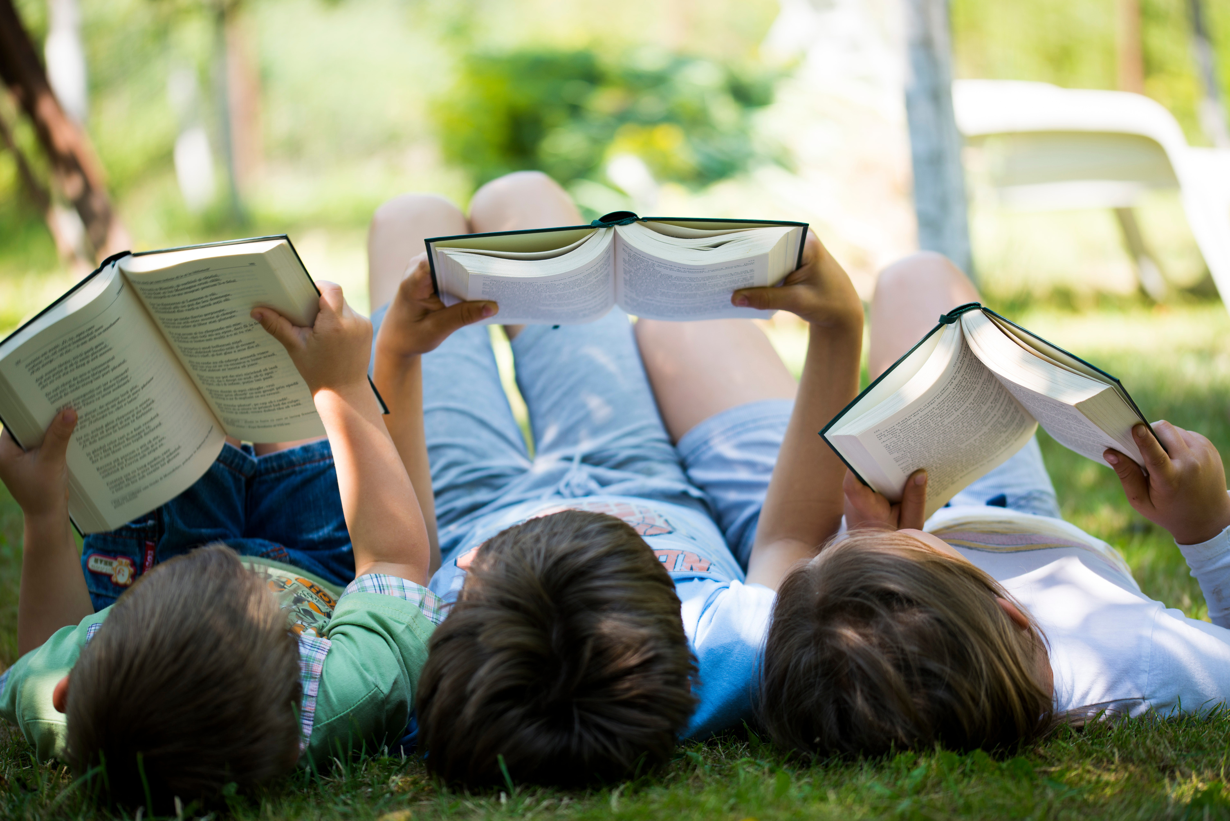
Read
Don’t Forget
to Read!

Slide 3
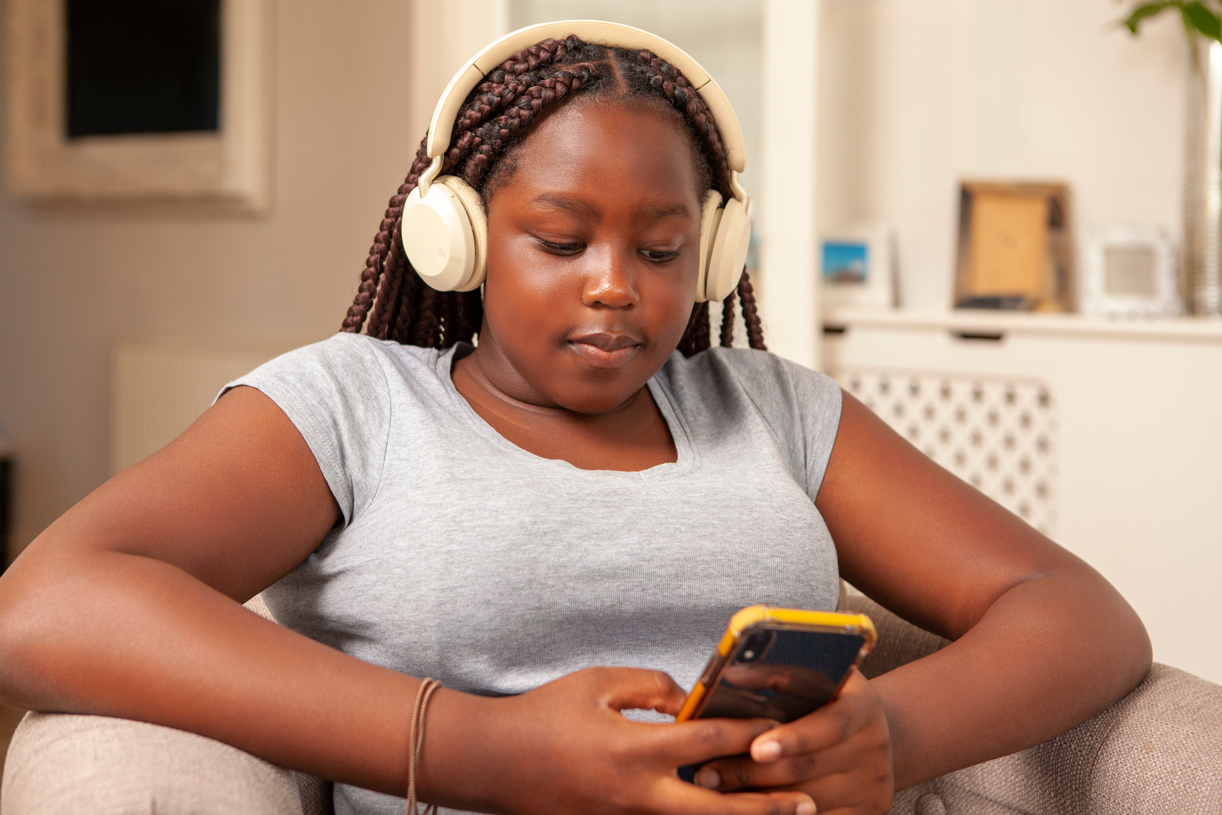
Listening
Listening to a story
counts as reading, too!

Slide 4
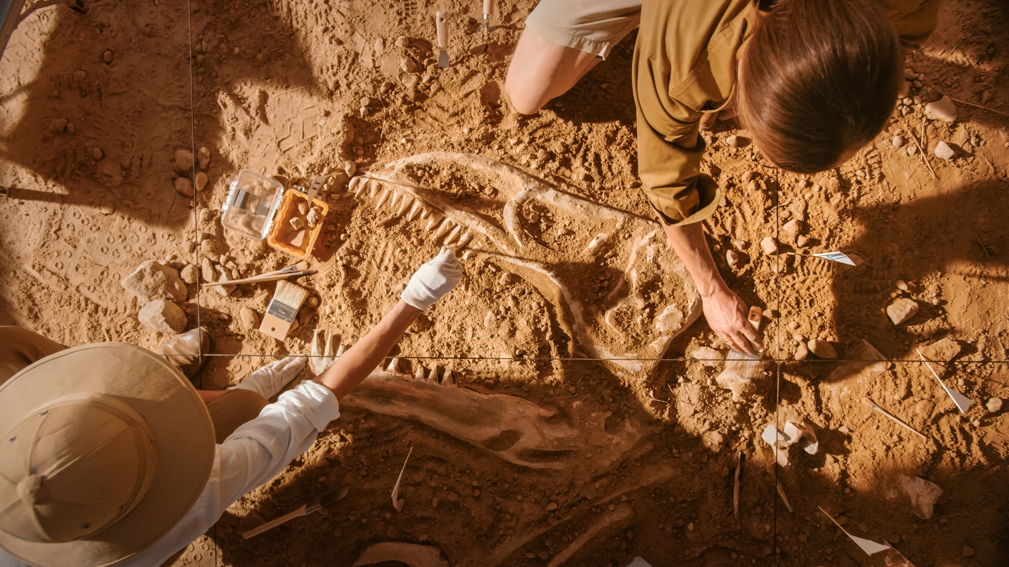
Unearth a Story
Summer Reading Program at

Slide 5
Age groups
Pre-readers: Ages 0-5
Kids Read: Grades K-5
Teens Read: Grades 6-12

Slide 6
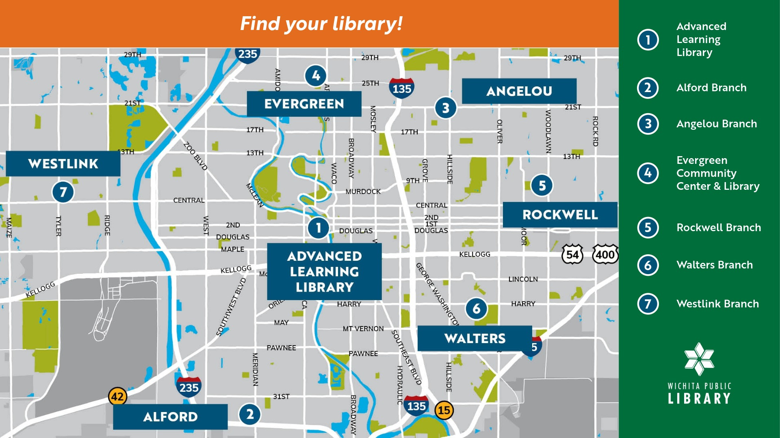
Library locations

Slide 7
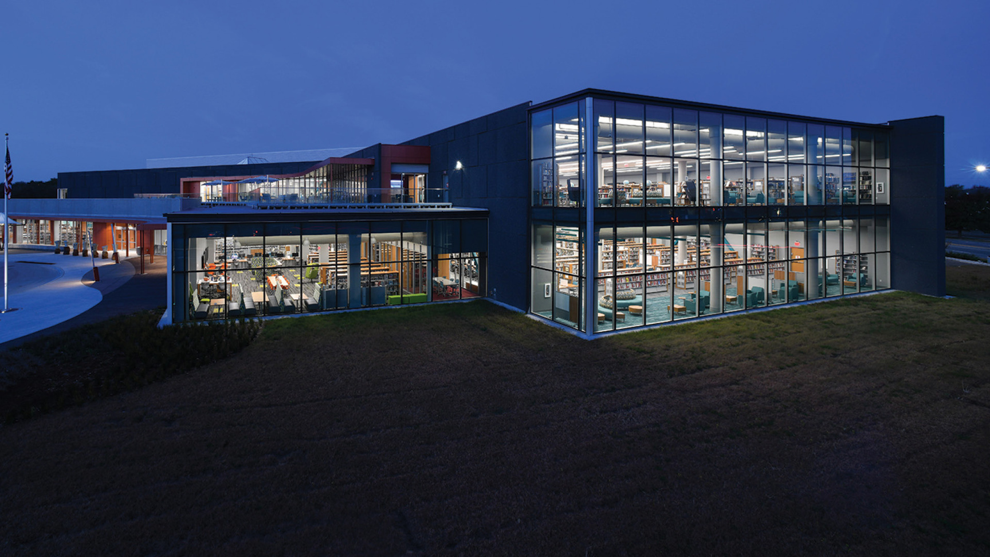
Advanced Learning Library
Advanced Learning Library

Slide 8
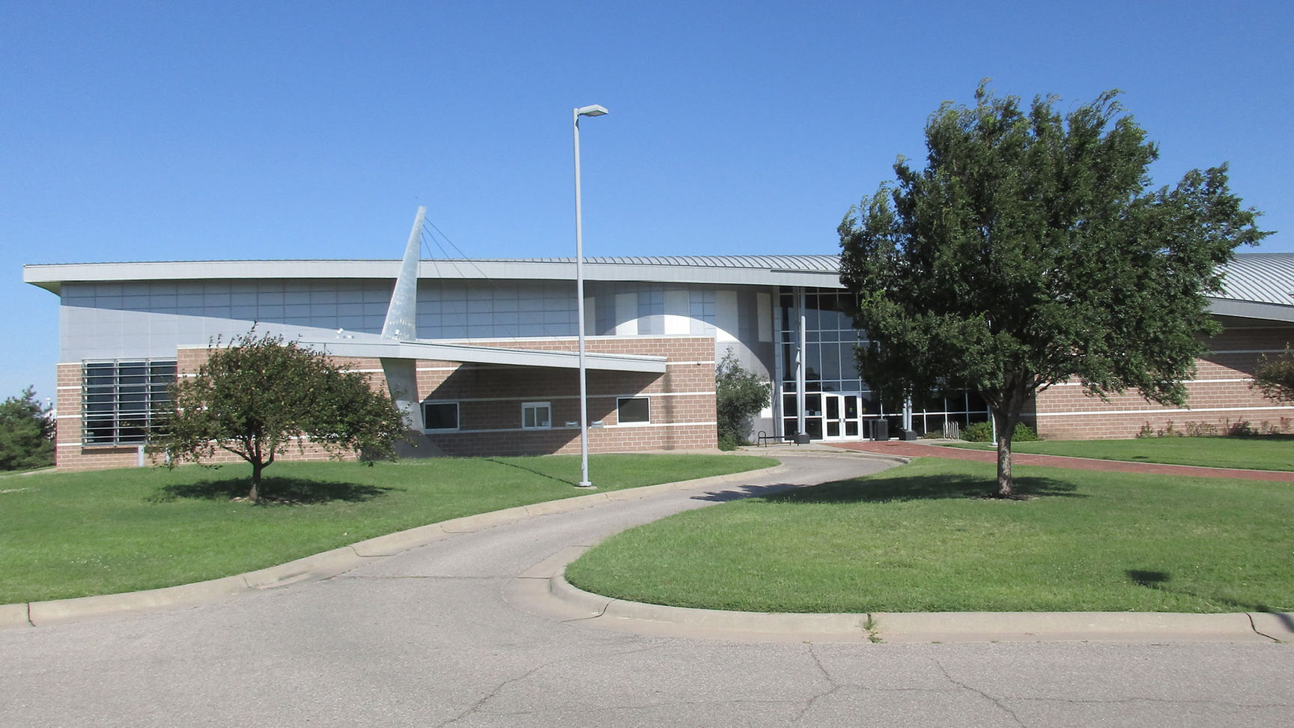
Alford
Alford Branch Library

Slide 9
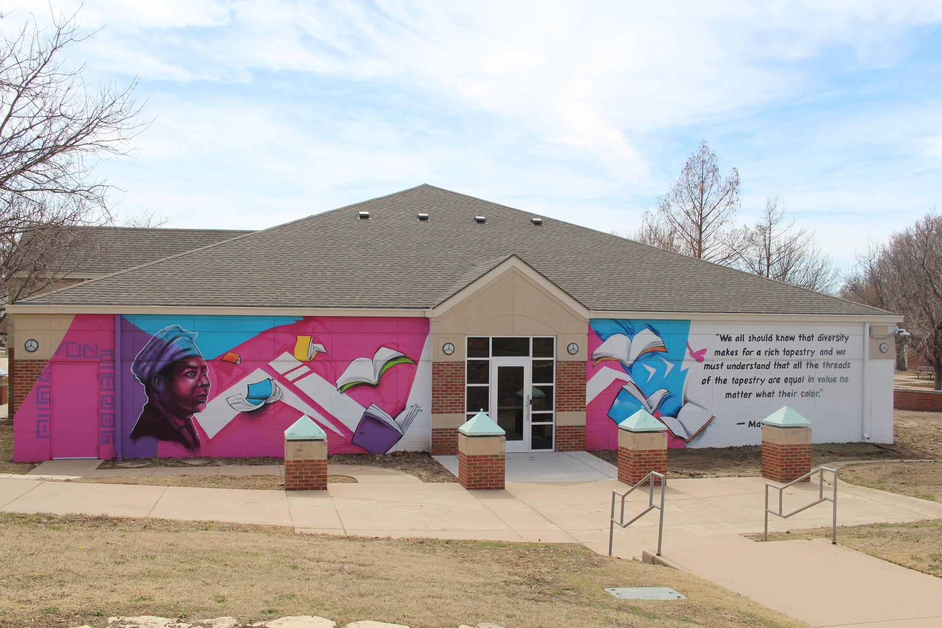
Angelou
Angelou Branch Library

Slide 10
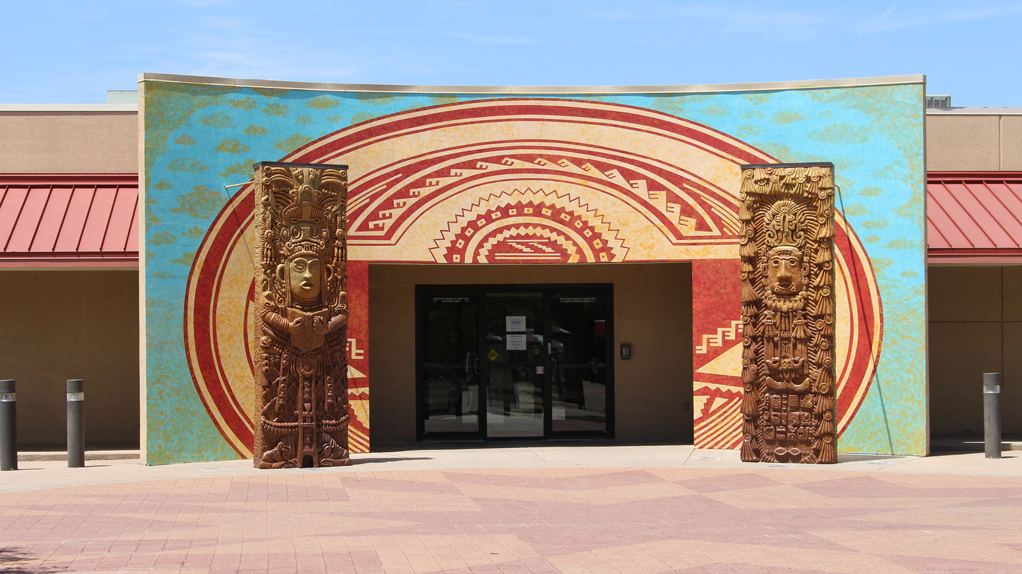
Evergreen
Evergreen Community Center & Library

Slide 11
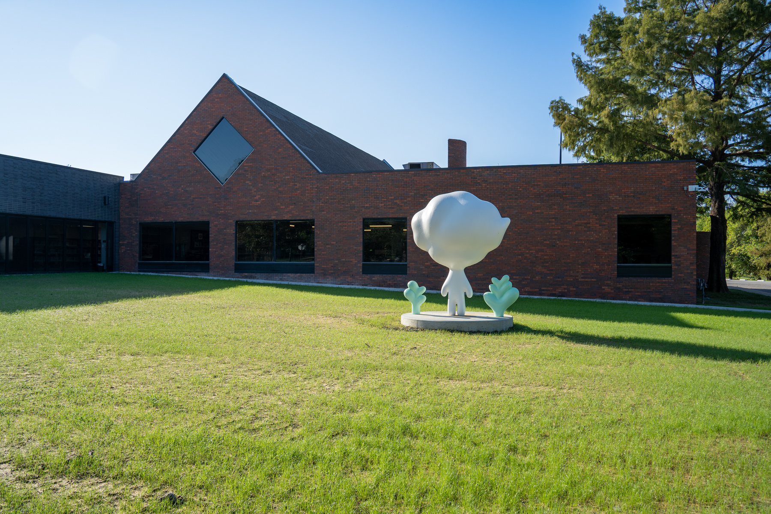
Rockwell
Rockwell Branch Library

Slide 12
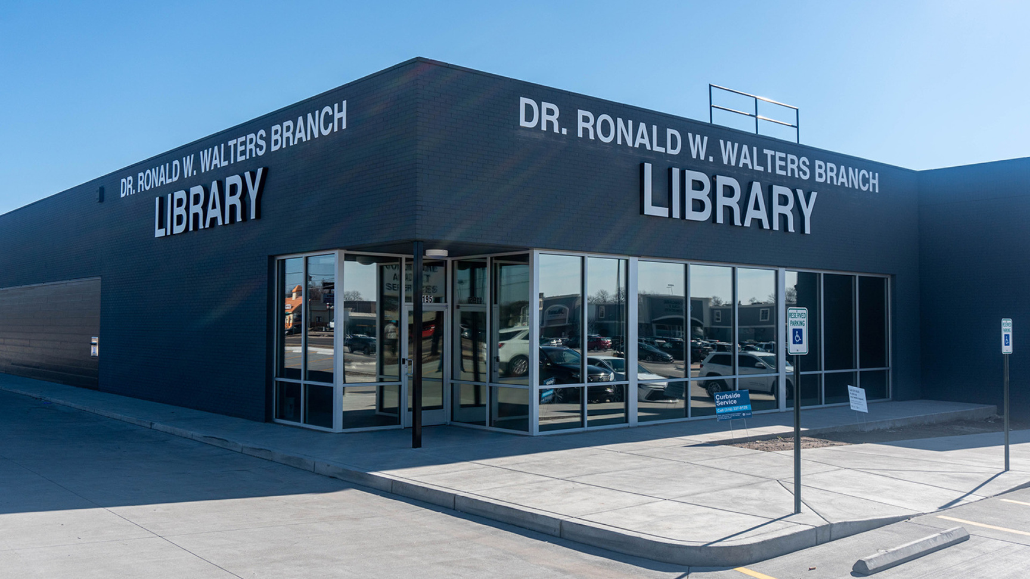
Walters
Walters Branch Library

Slide 13
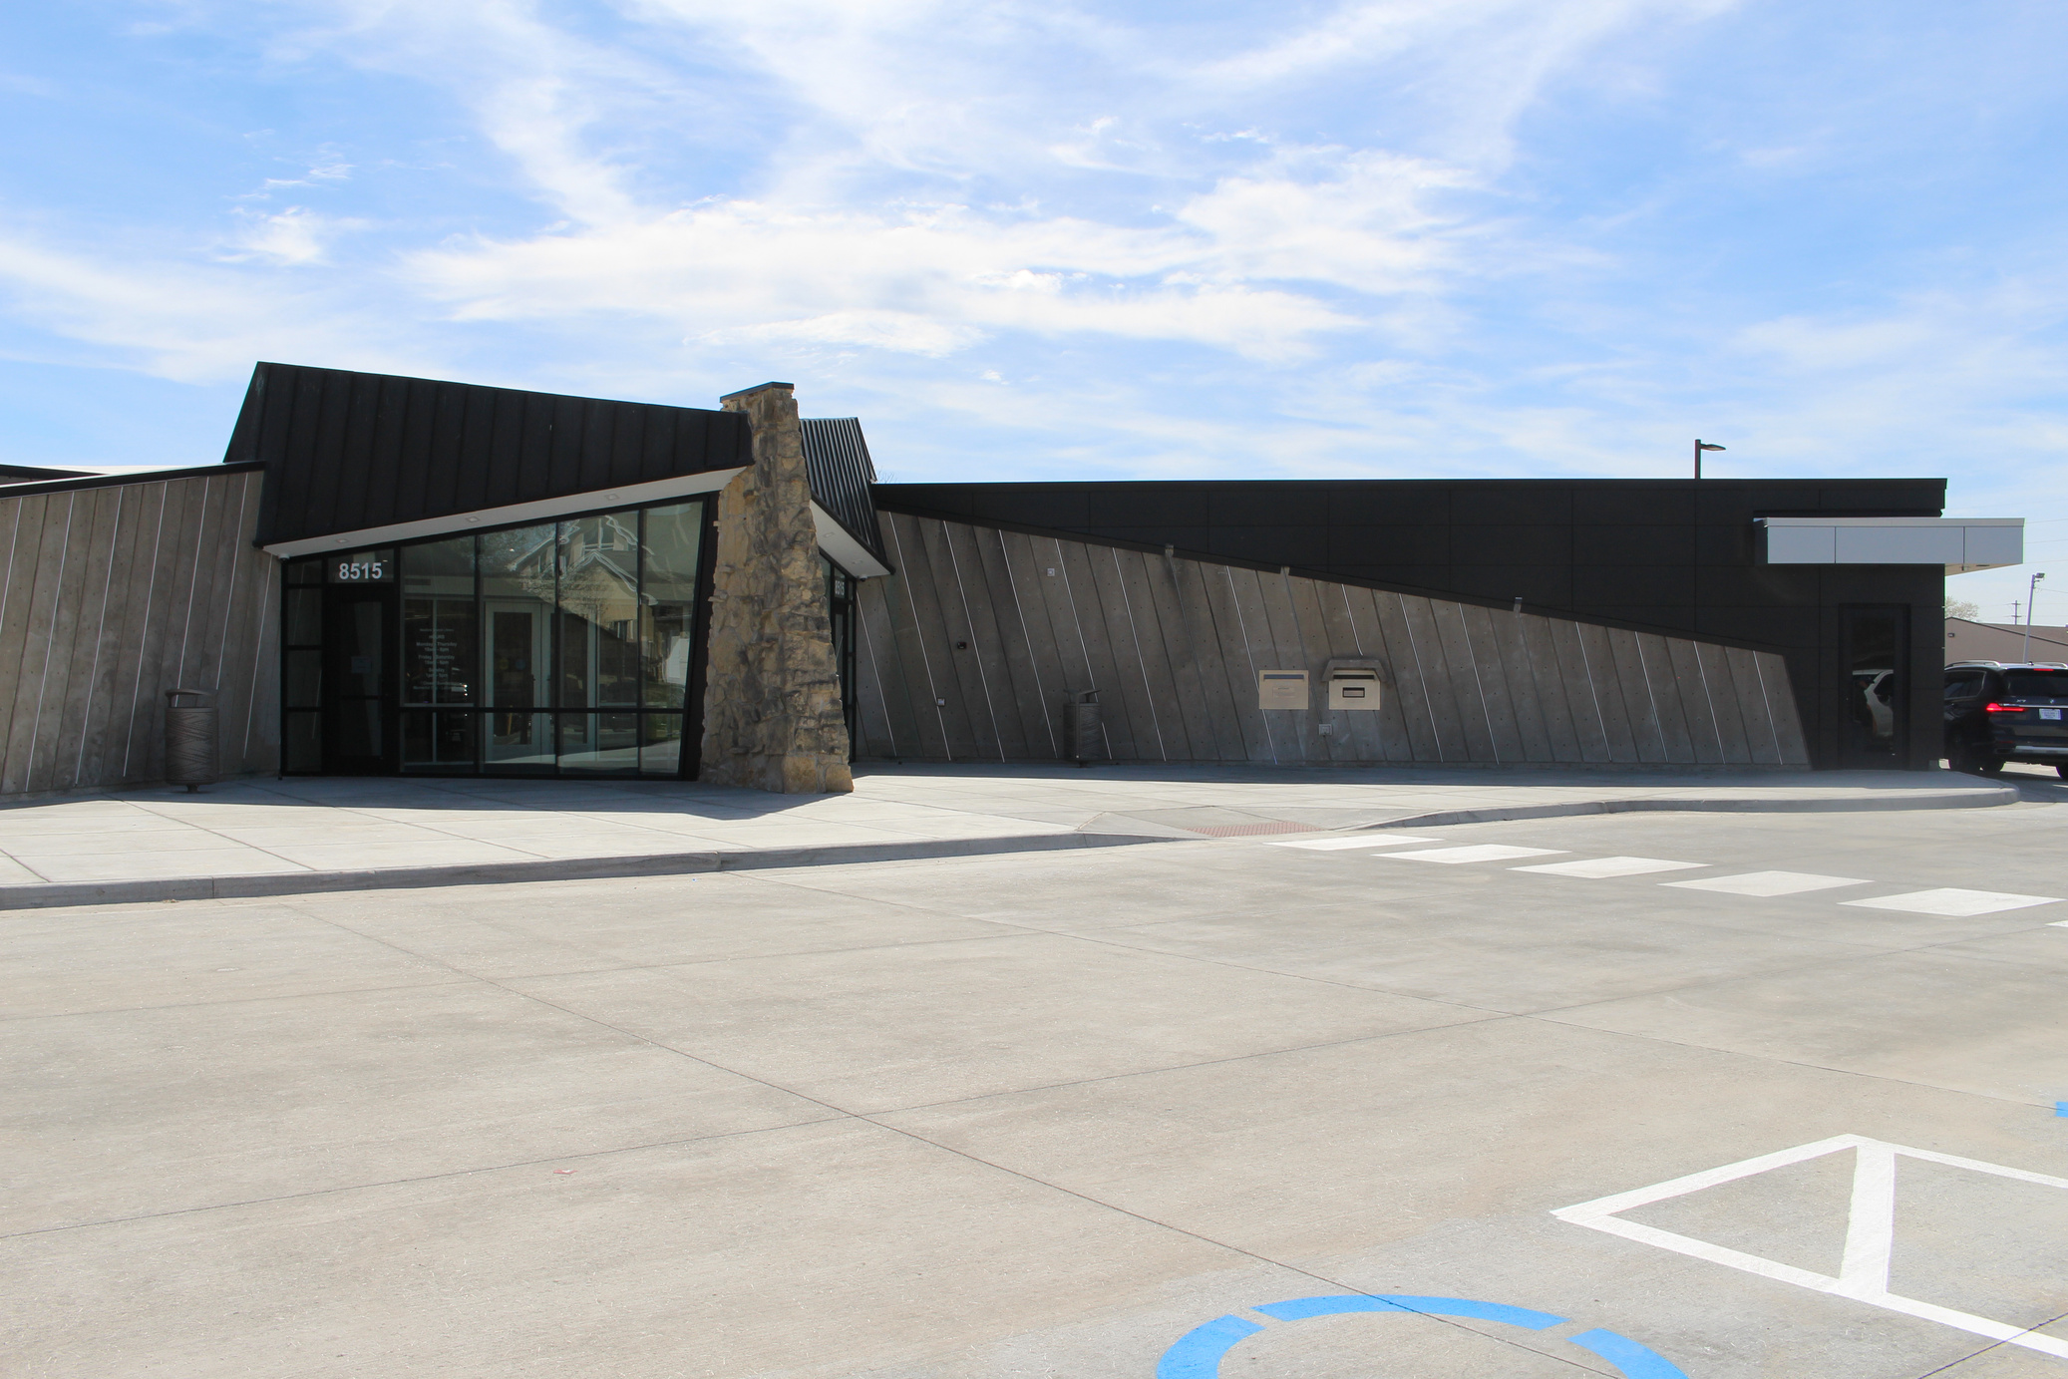
Westlink
Westlink Branch Library

Slide 14

Why should I read?
Why should I read?
Practice keeps you sharp for next year. Use it or lose it!
Spend quality time with your favorite characters.
Reading is a fun, free vacation for your mind!

Slide 15
Also
Also ...

Slide 16
Prizes
win free prizes!
Prize pickup begins June 25 and ends July 30

Slide 17














Prize Sponsors
Prize sponsors
& More!

Slide 18
Website
Discover more:
wichitalibrary.org/summerreading
wichitalibrary.org/events

